Slide 1

SCHOOL OF ELECTRICAL AND ELECTRONICS ENGINEERING(SEEE) B(TECH) PROJECT PRESENTATION ON : AC POWER CONTROLER WITH PROGRAMABLE INTERFACE” 21TH DECEMBER 2021(FINAL REVIEW)

Slide 2
CREDITS :
P
YASH CHANDAK - 20BAC10026
ANIKET VERMA - 20BAC10042
AARTI AJNAR - 20BAC10027
GUIDED BY – DR.NARENDRA BABU

Slide 3
OVERVIEW:
INTRODUCTION
OBJECTIVE
PROPOSED METHODOLOGY
CIRCUIT DIAGRAM
LIST OF COMPONENT \SOFTWARE \TOOL USED
WORK PLAN TILL NOW
VIRTUAL MODE EXPLANATION OF PROJECT
PLANNING
EXPECTED OUTCOME
CONCLUTION

Slide 4
1.
'INTRODUCTION’
“RECAP FROM REVIEW 2”

Slide 5
INTRODUCTION
The firing angle control of thyristors is done by the microcontroller, according to the desired percentage entered by the user. Based on this input the microcontroller will automatically adjust the power delivered to the lamp through a solid state switching mechanism.
This system overcomes the faults in the present system and provides solution for light illumination control.
This system is built by using an 8051 microcontroller and based on the principle of firing angle control of
thyristors, which in turn can control the illumination of lamp. An LCD display unit is used, which displays entered percentage of the illumination through a matrix keypad.

Slide 6
OBJECTIVE
RECAP FROM PROJECT 2

Slide 7
OBJECTIVE:
The main objective of this work is to vary the percentage of power supply by means of phase angle variation of the conduction period through the setting of different firing times corresponds of different firing angles.
At the end of the work we will able to :-
Have the full understanding of firing angle.
Understand the application of TRIAC and SCR in power electronics.

Slide 8
METHODOLOGY

Slide 9
METHODOLOGY
Ac power control with thyristor usinig microcontroller is designed to control AC power flow across load .
This project is designed using AT85s52 microcontroller and zero crossing detection circuit
Phase angle control method is used for AC power control with thyristor .
Thyristor is used as a switch to control flow of power
AT85s52 microcontroller is usd to detect zero crossing and to generate pulse signals at a specific angle for thyristors .

Slide 10
LIST OF COMPONENTS / SOFTWARE/TOOL USED

Slide 11
COMPONENTS REQUIRED:
Hardware Specifications
8051 series Microcontroller
Transformer
LCD
Diodes
keypad
TRIAC
Opto Isolator
Lamp
Software Specifications
Keil µVision IDE
MC Programming Language:
Embedded C

Slide 12
CIRCUIT DIAGRAM
RECAP FROM REVIEW 2

Slide 13
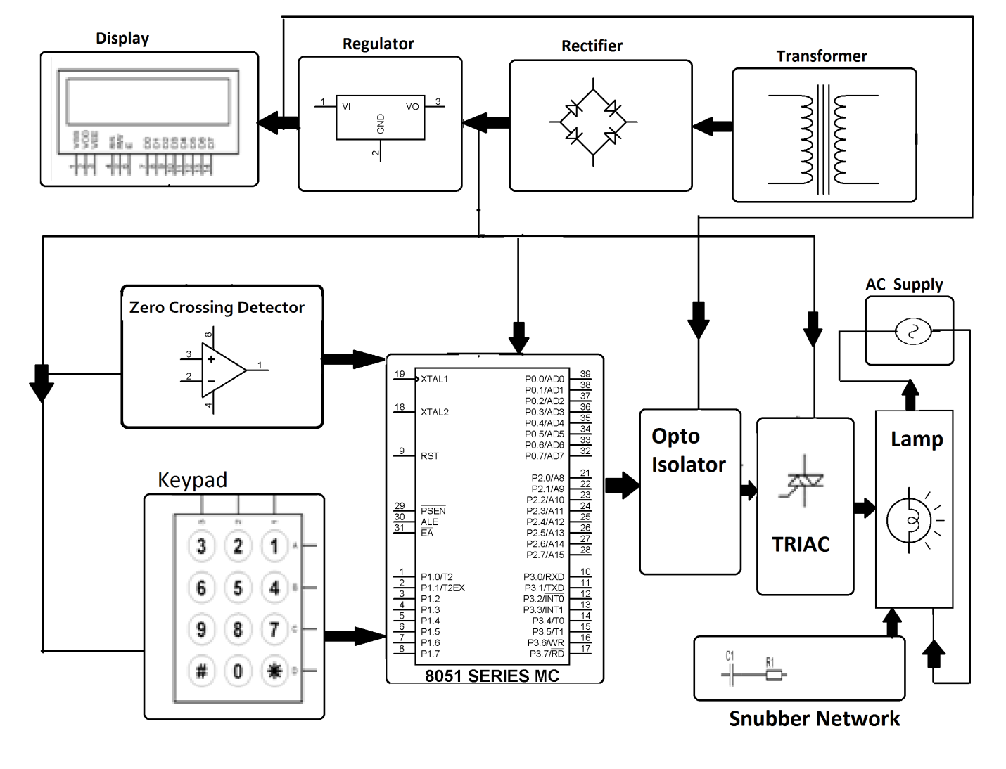
BLOCK DIAGRAM:

Slide 14
WORKED DONE TILL NOW
EXPLAINED BY - GIANT CHART REPRESENTATON

Slide 15
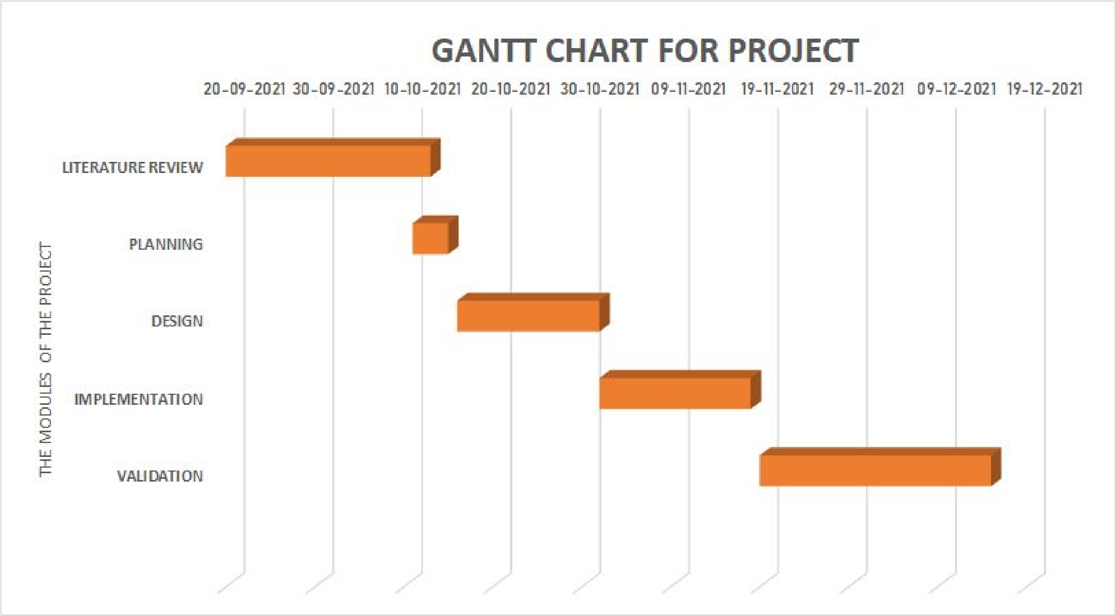


GANTT CHART OF THE PROJECT WORK PLAN REVIEW 1
15-12-2021

Slide 16
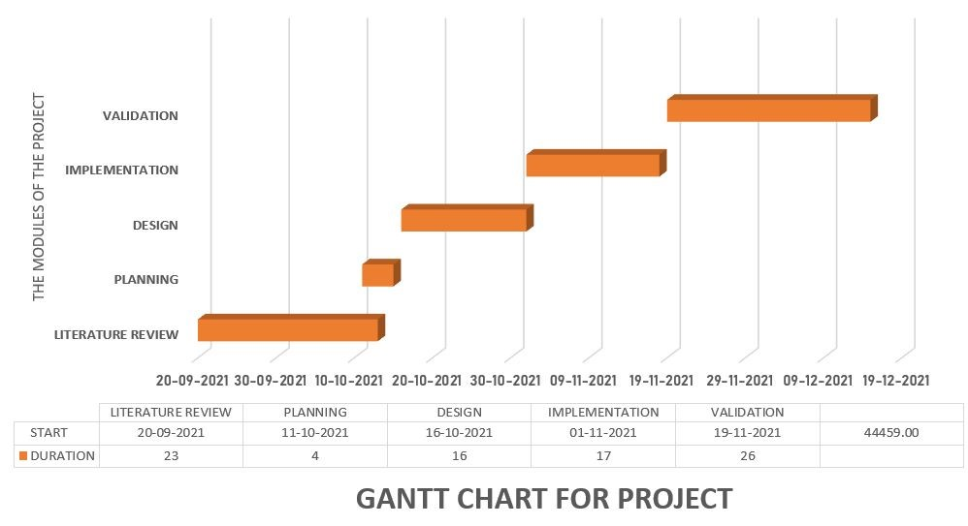
GANTT chart representation of the work plan
REVIEW 2
REVIEW 3
Review 1
Black
Is the color of ebony and of outer space. It has been the symbolic color of elegance, solemnity and authority.

Slide 17
FULL EXPLANATION OF PROJECT
IN SLIDE SHOW

Slide 18
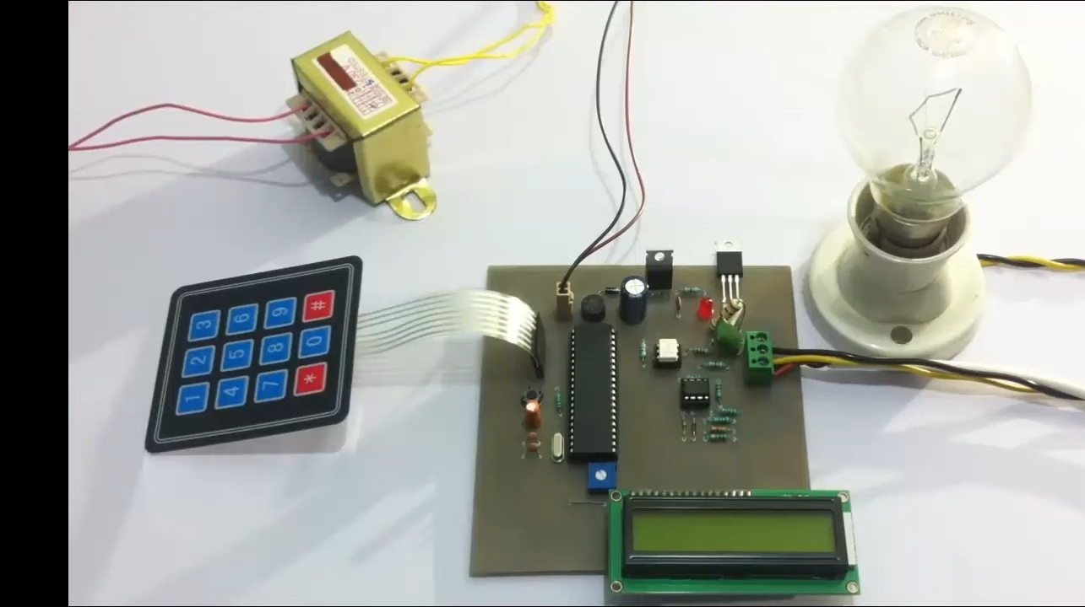

Slide 19
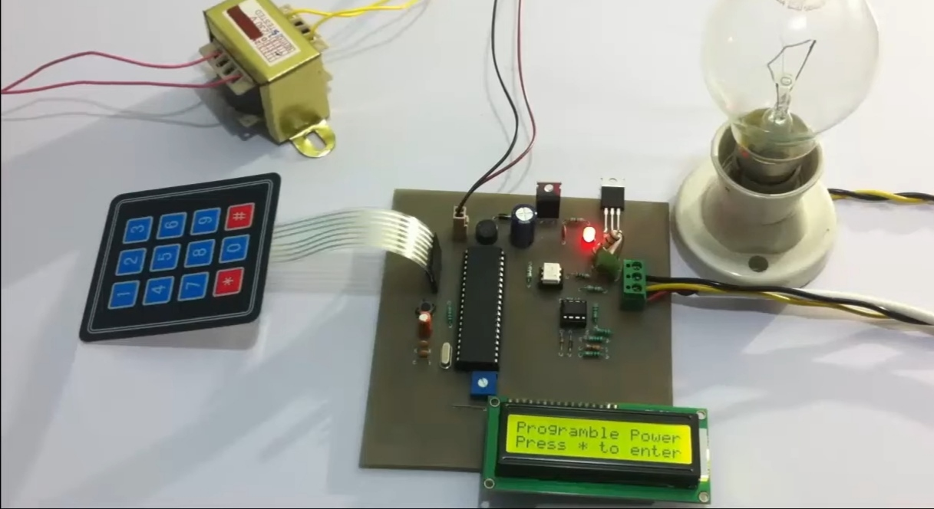

Slide 20
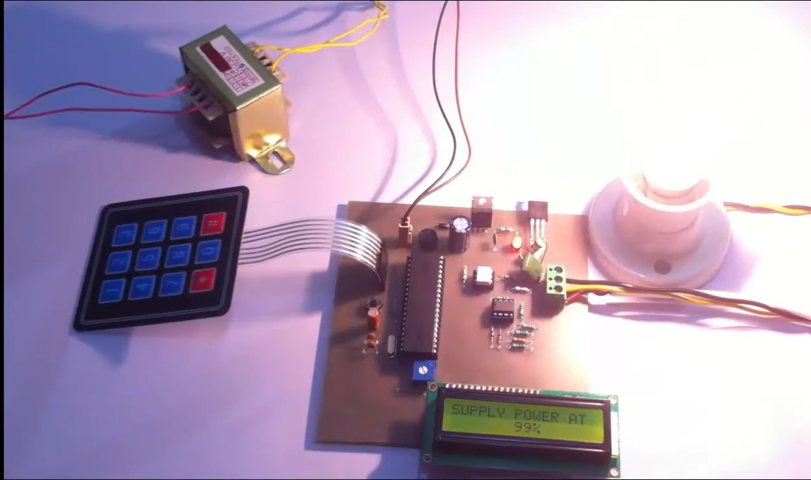

Slide 22
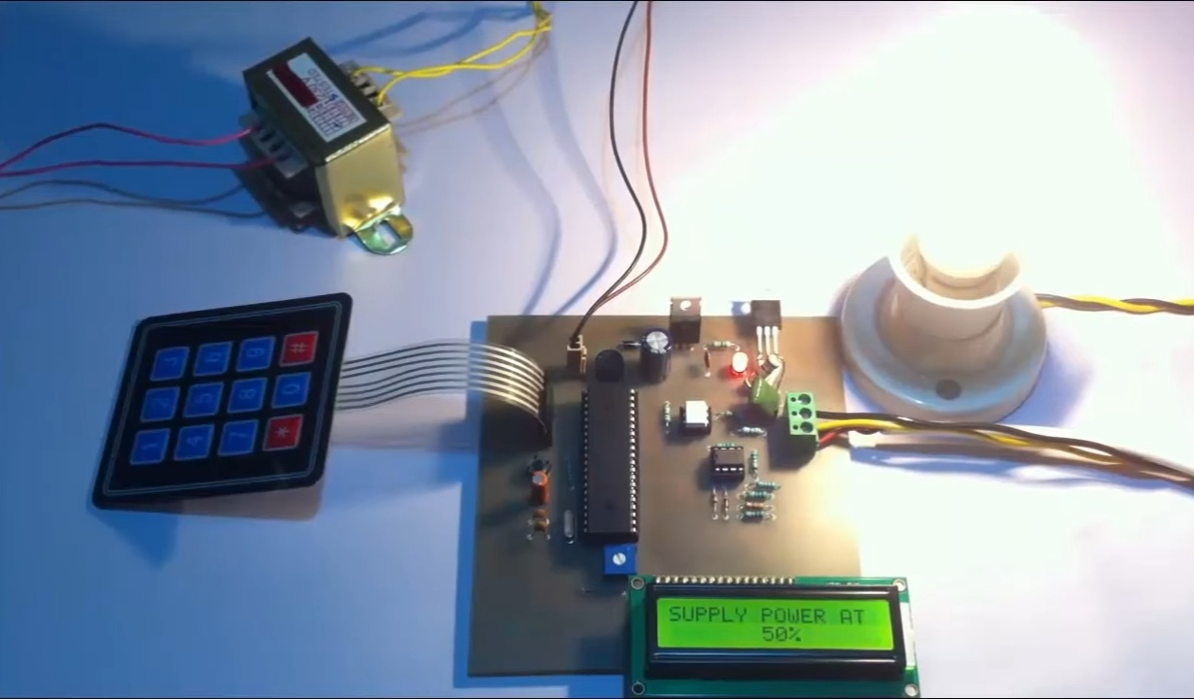

Slide 23
PLANNING
TLL NOW

Slide 24
PLANNING WE HAVE DONE TILL NOW
As mentioned earlier, our trained model is ready and is working successfully.
As for what's now the model must be able to detect all the intensity for required percentage signs and give relevant output with respect to that.
The work done till now has all been a smooth sail right from downloading the data set to training the model, however we were successfully able to eradicate the errors and bugs in the project that we had written till now.

Slide 25
EXPECTED OUTCOME

Slide 26
EXPECTED OUTCOME
The work is on contolling the AC power by using the concept of firing angle control of thyristors .
One can enter the required percentage of power supply through a keypad .
The input is provided to a miocrocontroller of 8051 family that initiate the firing angle to adjust the load power .
For matching the power to the required one, aTRIAC is used in series with the AC load .
A LCD screen is used to display the power percentage that is provided by the user

Slide 27
CONCLUTION

Slide 28
CONCLUTION
This work is used at controlling the AC power by using the concept of firing angle control of thyristors.
With this device one can enter the required percentage of power supply through a keypad

Slide 29
REFERENCE
Lee Siang Tat, YiauwKahHaur “AC Power Controller By Using Microcontroller”. ISSN:2180-1843 eISSN:2289-8131.Vol.8 No.12.
David Margulies, Clifford E. Felder, Galina Melman and Abraham Shanzer “A Molecular Keypad Lock: A Photochemical Device Capable Of Authorizing Password Entries”. Cite This:J.Am.Chem.Soc.2007,129,2 347-354 Publication date: December 19,2006.https://doi.org/10.1021/ja065317z.
Web ProForum Tutorials, “Global System for Mobile Communication (GSM)”, The International Engineering Consortium, http:// www.iec.org.com USA.
Gunnar Heine, “GSM Networks: Protocols, Terminology, and Implementation”, British Library, ISBN:0-89006-471-7, London, 1999

Slide 30


Slide 31


